Slide 1

TO DO LIST MANAGEMENT SYSTEM
NATIONAL ENGINEERING COLLEGE,KOVILPATTI
(An Autonomous Institution – Affiliated to Anna University, Chennai)
23CS24C-OBJECT ORIENTED PROGRAMMING
EXPERIENTIAL LEARNING
Team members:
Arockya Abinesh A - 2311123
Arikarasudhan M - 2311088
Gowshik N – 2311096
Lakshmi Narasimman S - 2311100
Course Instructor:
G.Pavithra
Assistant Professor
CSE

Slide 2
Problem Statement
Objective
There is a need for a comprehensive To-Do List Management System that can efficiently manage various types of tasks, including personal, work, and shopping tasks. The system should be capable of handling multiple tasks with different priorities, deadlines, and categories. Moreover, it should provide features for updating task details, deleting tasks, marking tasks as completed, and searching for tasks by category or deadline.
The existing systems lack a user-friendly interface, robust exception handling, and secure data storage mechanisms. They also fail to provide a seamless user experience, making it difficult for users to manage their tasks effectively.
Create and Manage Tasks: The system should allow users to create, edit, and delete tasks, including personal, work, and shopping tasks.
Organize and Track Tasks: The system should provide a way to categorize, prioritize, and track task progress, making it easy for users to focus on the most important tasks.
Provide Reminders and Notifications: The system should provide reminders for upcoming deadlines and tasks, ensuring users stay on track and meet their commitments.

Slide 3
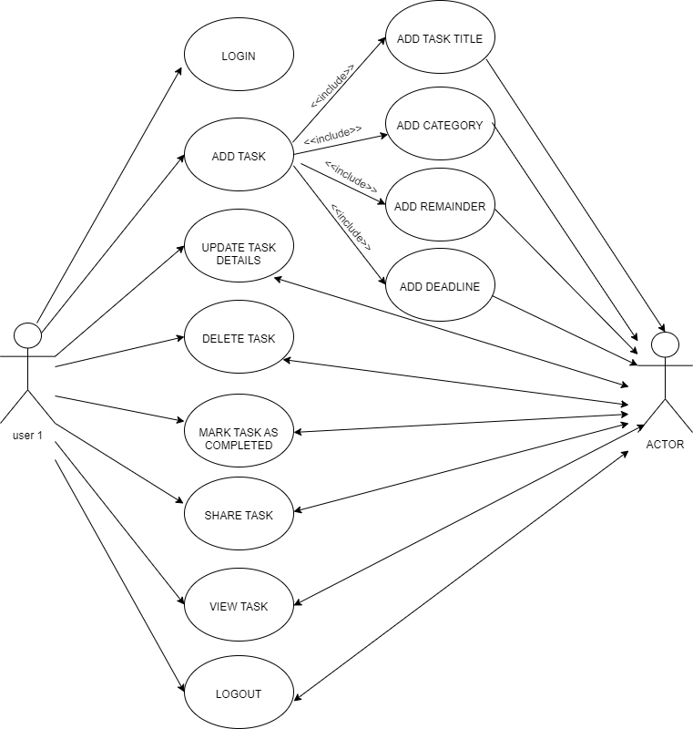
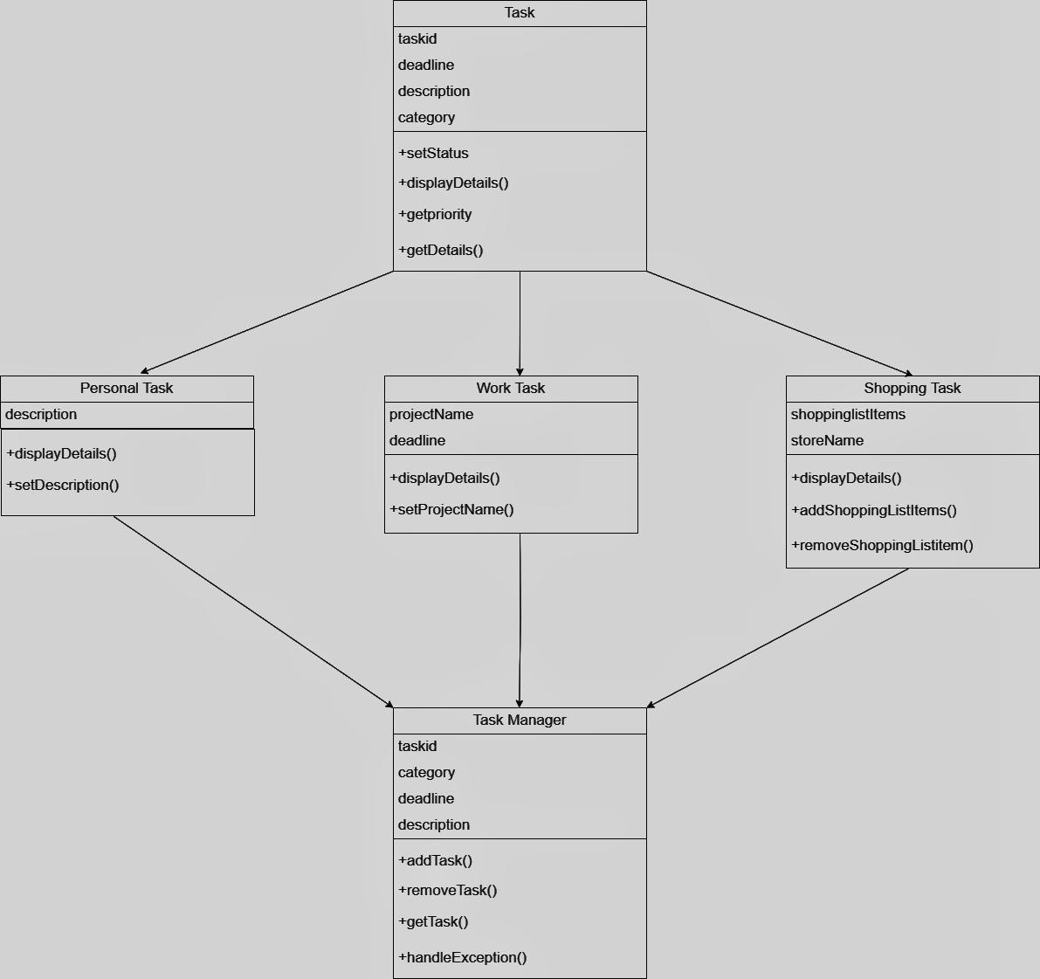
Use Case Study and Class Diagram

Slide 4
Polymorphism and Dynamic Binding
Virtual functions in the base class `Task` (e.g., `viewTaskDetails() that are overridden in the derived classes to provide task-specific details.
Input & Output file
Input file: The loadTasksFromFile method reads tasks from a file specified by the filename parameter. The file is expected to be a text file with each line representing a task in a specific format.
Output file: The saveTasksToFile method writes tasks to a file specified by the filename parameter. The file is created or overwritten with the task data in a specific format.
User interface
Create an interactive user interface for managing tasks, allowing users to:
+ Add new tasks.
+ Update existing task details.
+ Delete tasks.
+ Mark tasks as completed.
+ Search for tasks by category or deadline.
+ View task details.

Slide 5
Exception
In the updateTask method of the TaskManager class: void updateTask(string name, int priority, string deadline) {
for (auto& task : tasks) {
if (task->getName() == name) {
task->setPriority(priority);
task->setDeadline(deadline);
return;
}
}
throw runtime_error("Task not found");
}
//Here, you throw a runtime_error exception if the task with the given name is not found.
In the deleteTask method of the TaskManager class:
void deleteTask(string name) {
for (auto it = tasks.begin(); it!= tasks.end(); ++it) {
if ((*it)->getName() == name) {
delete *it; // Free memory of the task being deleted
tasks.erase(it);
return;
}
}
throw runtime_error("Task not found");
}
//throw a runtime_error exception if the task with the given name is not found.
In the viewTaskDetails method of the TaskManager class
void saveTasksToFile(const string& filename) {
ofstream file(filename);
if (!file) {
throw runtime_error("Failed to open file for writing");
}
//...
}
throw a runtime_error exception if the task with the given name is not found.

Slide 6
Output
https://drive.google.com/file/d/1KudGvHSw5_mYrEwpVasuxpbWS2s-aI7n/view?usp=sharing

Slide 7
